Slide 1
Software Construction Laboratory CS35L – Lab 1
Course Webpage: https://web.cs.ucla.edu/classes/fall18/cs35L/index.html
TA: Zhiyi Zhang
Email: zhiyi@cs.ucla.edu
Webpage: https://zhiyi-zhang.com

Slide 2
Session 8-2
Network Security
Cryptography 101
SSH

Slide 3
Network Security

Slide 4
Communication Over the Internet
What type of guarantees do we want?
Data integrity: Message consistency
Authentication: Identity confirmation
Authorization: Specifying access rights to resources
Confidentiality: Message secrecy
Availability: Resources are available when needed
Non-repudiation: One cannot deny its transactions
…
Notes:
confidentiality, integrity, and availability (CIA Triangle)

Slide 5
Powerful Tools: Cryptography
Hash
Digital Signature
Symmetric Key Encryption
Asymmetric Key Encryption
…
With cryptography, people design protocols that secure the communication.
E.g., SSH, TLS/SSL, DNSSEC, BGP-SEC, Bitcoin, …

Slide 6
Cryptography 101

Slide 7
Recall: Encryption Types
Symmetric Key Encryption
a.k.a shared secret/key
Key used to encrypt is the same as key used to decrypt
Asymmetric Key Encryption: Public/Private
2 different (but related) keys: public and private
Only creator knows the relation. Private key cannot be derived from public key
Data encrypted with public key can only be decrypted by private key and vice versa
Public key can be seen by anyone but never publish private key!!!

Slide 8
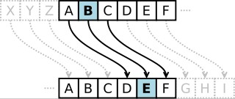
Symmetric-key Encrption
Same secret key used for encryption and decryption
Typical example: Caesar’s cipher, Data Encryption Standard (DES), Advanced Encryption Standard (AES)
Caesar's cipher
Map the alphabet to a shifted version
Key is 3 (number of shifts of the alphabet)
Key distribution is a problem
The secret key has to be delivered in a safe way to the recipient
Diffie Hellman

Slide 9
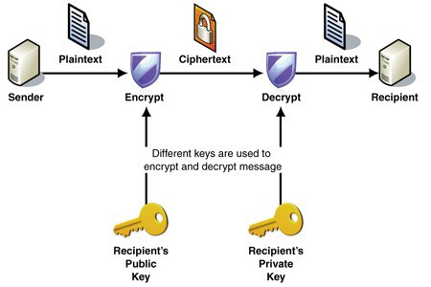
Public-key Encryption (Asymmetric)
Uses a pair of keys for encryption
Public key – Published and known to everyone
Private key – Secret key known only to the owner
Encryption
Use public key to encrypt messages
Anyone can encrypt
Decryption
Use private key to decrypt message
Example: RSA, ABE

Slide 10
Digital Signature
An electronic stamp or seal
Almost exactly like a written signature, except more guarantees!
Is appended to a message
Or sent separately (detached signature)
Ensures data integrity and authenticity
Data was not changed during transmission
Data was truly signed by the private key

Slide 11
Steps for Generating a Digital Signature
Generate a Message Digest
The message digest is generated using a set of hashing algorithms
A message digest is a 'summary' of the message we are going to transmit
Create a Digital Signature
The message digest is encrypted using the sender's private key. The resulting encrypted message digest is the digital signature
Attach digital signature to message and send to receiver
Notes:
Even the slightest change in the message produces a different digest

Slide 12
Steps for Verifying a Digital Signature
Recover the Message Digest
Decrypt the digital signature using the sender’s public key to obtain the message digest generated by the sender
Generate the Message Digest by the receiver itself
Use the same message digest algorithm used by the sender to generate a message digest of the received message
Compare digests (the one sent by the sender as a digital signature, and the one generated by the receiver)
If they are not exactly the same => the message has been tampered with by a third party

Slide 13
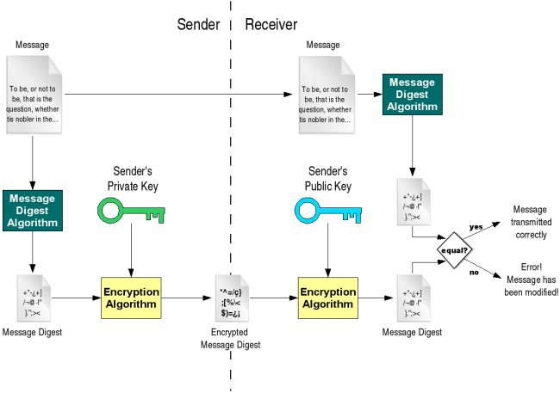
Digital Signature

Slide 14
Message Authentication Code
MAC confirms that the message came from the stated sender (its authenticity) and has not been changed (its integrity)
A strawman solution
Hash(Message)
keyed-hash message authentication code (HMAC)
A specific type of message authentication code (MAC) involving a cryptographic hash function and a secret cryptographic key
Two parties use the shared key to generate HMAC
HMAC is generated over the message and the key

Slide 15
SSH

Slide 16
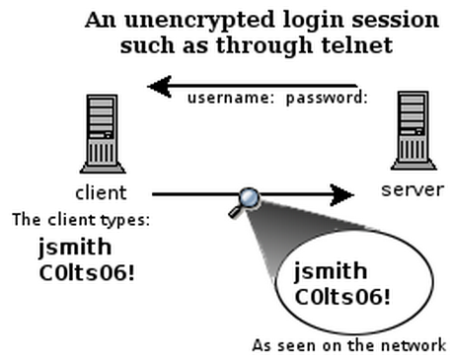
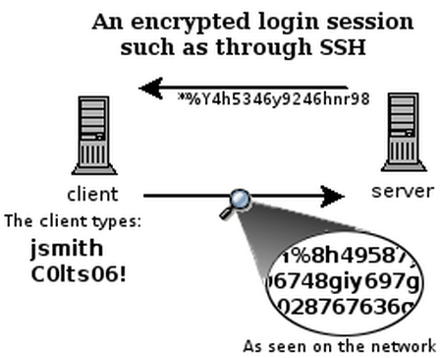
What is SSH?
Secure Shell
Used to remotely access shell
Successor of telnet
Encrypted and better authenticated session
CONFIDENTIAL

Slide 17
How does SSH work?
Based on TCP protocol (IP address + port number)
Enroll CS118 if you are not familiar with TCP/IP network
Public Key Signature to provide host authentication
Symmetric Key Encryption to ensure message confidentiality
Message Authentication Code (MAC) to ensure integrity
Password or Public Key Signature to provide user authentication

Slide 18
SSH Command
Client ssh’s to remote server
ssh connects and logs into the specified destination
Format: ssh [options] [username@]hostname
Examples
ssh 192.168.1.2
ssh root@192.168.1.2
ssh zhiyi@lnxsrv09.seas.ucla.edu
ssh -p 8022 192.168.1.2
Use the port 8022 instead of the default 22

Slide 19
First-Time SSH and Host Validation
If ssh for the first time, the host validation process will be triggered
TOFU: Trust on First Time Use.
SSH shows hostname, IP address and fingerprint of the server’s public key, so you can be sure you're talking to the correct host
The authenticity of host 'somehost (1.2.3.4)' can't be established. RSA key fingerprint is blablabla. Are you sure you want to continue connecting (yes/no)?
After accepting, the host public key is saved in ~/.ssh/known_hosts

Slide 20
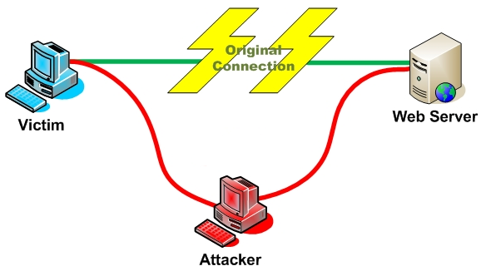
Host Validation
Next time client connects to server
Check host’s signature using the public saved
Man In The Middle (MITM) Attack?

Slide 21
Session Encryption and Data Integrity
Client and server agree on a symmetric encryption key (session key)
Diffie-Hellman
All messages sent between client and server
MAC (message authentication code) calculated
encrypted at the sender with session key
decrypted at the receiver with session key
MAC (message authentication code) verified
Anybody who doesn't know the session key doesn't know any of the contents of those messages

Slide 22
User Authentication
Password-based authentication
Prompt for password on remote server
If username specified exists and remote password for it is correct then the system lets you in
Key-based authentication
The Client side generates a digital signature using the client’s private key
The Server side verifies the signature using client’s public key
Client’s key must be known to the Server in advance

Slide 23
ssh-agent
The ssh-agent is a helper program that keeps track of user's identity keys and their passphrases.
The agent can then use the keys to log into other servers without having the user type in a password again
ssh-add command to add private key identities to the authentication agent
When run without arguments, it adds the files ~/.ssh/id_rsa, ~/.ssh/id_dsa, ~/.ssh/id_ecdsa, and ~/.ssh/id_ed25519
ssh-agent is automatically configured and run at login, and no additional actions are required to use it
Notes:
In public-key cryptography, Edwards-curve Digital Signature Algorithm (EdDSA) is a digital signature scheme using a variant of Schnorr signature based on Twisted Edwards curves.

